Slide 1
HTML5 structure for website

Slide 2
CSS Resets
A CSS reset is a set of styles that aims to override the default styles applied by browsers to HTML elements.
The goal is to create a consistent starting point for styling across different browsers by removing or resetting browser-specific styling.
This helps ensure that developers have a clean slate and can apply their styles consistently across various platforms.

Slide 3
When using CSS resets, developers often include rules that set margins, padding, and other styles to a consistent baseline. The idea is to neutralize the default styling differences between browsers so that developers can build their designs without unexpected variations.
/* CSS Reset */
body, h1, h2, p, ul, li {
margin: 0;
padding: 0;
}
/* Add more styles as needed */

Slide 4
html, body, div, span, applet, object, iframe,
h1, h2, h3, h4, h5, h6, p, blockquote, pre,
a, abbr, acronym, address, big, cite, code,
del, dfn, em, img, ins, kbd, q, s, samp,
small, strike, strong, sub, sup, tt, var,
b, u, i, center,
dl, dt, dd, ol, ul, li,
fieldset, form, label, legend,
table, caption, tbody, tfoot, thead, tr, th, td,
article, aside, canvas, details, embed,
figure, figcaption, footer, header, hgroup,
menu, nav, output, ruby, section, summary,
time, mark, audio, video {
margin: 0;
padding: 0;
border: 0;
font-size: 100%;
font: inherit;
vertical-align: baseline;
}
/* HTML5 display-role reset for older browsers */
article, aside, details, figcaption, figure,
footer, header, hgroup, menu, nav, section {
display: block;
}
body {
line-height: 1;
}
ol, ul {
list-style: none;
}
blockquote, q {
quotes: none;
}
blockquote:before, blockquote:after,
q:before, q:after {
content: '';
content: none;
}
table {
border-collapse: collapse;
border-spacing: 0;
}

Slide 5
<style>
.parent {
width: 200px;
}
.box {
width: 100%;
border: 2px solid hotpink;
padding: 20px;
}
</style>
<div class="parent">
<div class="box"></div>
</div>

Slide 6
HTML5:
HTML5 is the fifth and latest version of the Hypertext Markup Language used to structure content on the web. It introduces new elements and attributes that provide better semantics and improved support for multimedia elements. HTML5 is designed to be backward compatible with older HTML versions while offering new features to enhance the capabilities of web documents.
For example, HTML5 introduces new semantic elements such as <header>, <nav>, <article>, <section>, <footer>, and more. These elements provide better structure and meaning to the content, making it easier for developers and search engines to understand the document's hierarchy.

Slide 7
Relationship:
When working with HTML5, developers may still choose to use a CSS reset to ensure a consistent starting point for styling, as HTML5 itself doesn't dictate specific styles. However, some argue that with HTML5's improved default styling for certain elements, the need for extensive CSS resets has diminished.
Developers might also choose to use a "normalize" stylesheet, like Normalize.css, which preserves useful default styles while addressing inconsistencies across browsers. The decision to use a CSS reset or normalization depends on the specific needs of the project and the developer's preferences.

Slide 8
html for container
In HTML, a container is not a specific HTML element but rather a term used to describe an element that wraps or contains other elements. Commonly used container elements include <div>, <section>, <article>, <main>, and <aside>. The choice of which container to use depends on the semantics and structure of your content.

Slide 9
<style> /* Some basic styling for demonstration purposes */ body
{
font-family: Arial, sans-serif; margin: 0; padding: 0; box-sizing: border-box;
}
.container
{
max-width: 800px; margin: 0 auto; padding: 20px; background-color: #f0f0f0;
}
</style>
<div class="container">
<h1>This is a Container Example</h1>
<p>
This container is a <code>&lt;div&gt;</code>
element with some basic styling applied.
</p>
<p>It wraps and contains the content inside.</p>
</div>

Slide 10

Html5 header
In HTML5, the <header> element is used to define a header section for a document or a specific section within a document. The <header> tag typically contains introductory content, navigational links, headings, logos, or other elements that are relevant to the overall header of the page or a section.

Slide 11
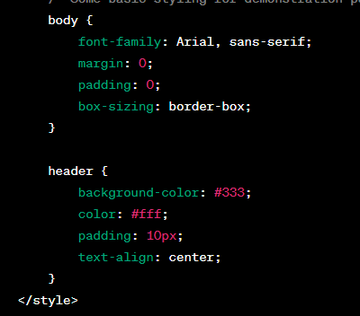
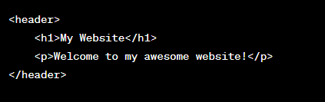
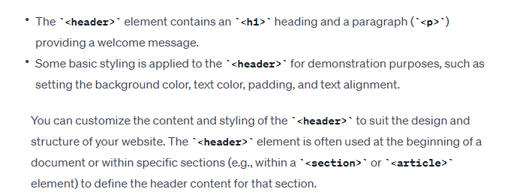

Slide 12
<header> is used within an <article> element
<article>
<header>
<h2>Article Title</h2>
<p>Published on January 1, 2024</p>
</header>
<p>Content of the article...</p>
</article>
In this case, the <header> is used to encapsulate the title and publication information specific to that article. The use of <header> helps convey the semantic meaning of the contained content.

Slide 13
navigation
In HTML5, the <nav> element is used to define a navigation menu on a webpage. The <nav> tag is typically used to group together navigation links that lead to other pages within the same website or external resources. Here's a basic example of an HTML5 navigation bar using the <nav> element:

Slide 14
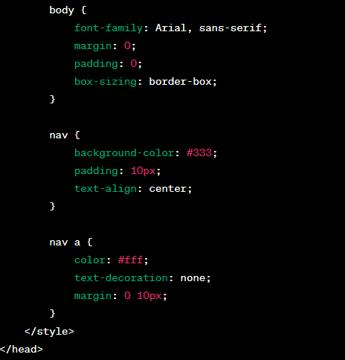
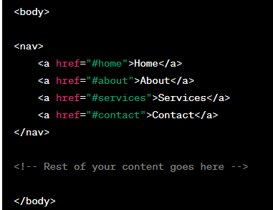
The <nav> element contains a series of <a> (anchor) elements, representing navigation links.
Basic styling is applied to the <nav> and <a> elements for demonstration purposes, setting background color, text color, padding, and spacing.
You can customize the content and styling of the navigation bar based on the design and structure of your website. The <nav> element is used to semantically mark up navigation sections of a webpage, making it more accessible and providing a clear structure for both developers and assistive technologies.

Slide 15
Four-column content area in HTML
four-column content area in HTML can be achieved by using a combination of HTML elements and CSS styling. Below is a simple example of a four-column layout using the <div> element for each column:

Slide 16
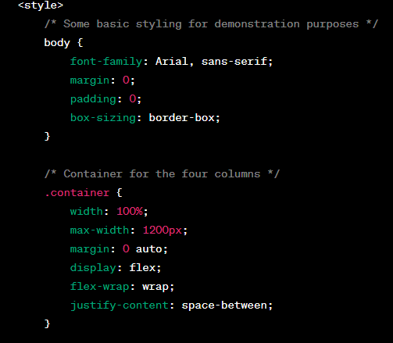
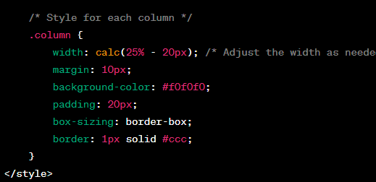
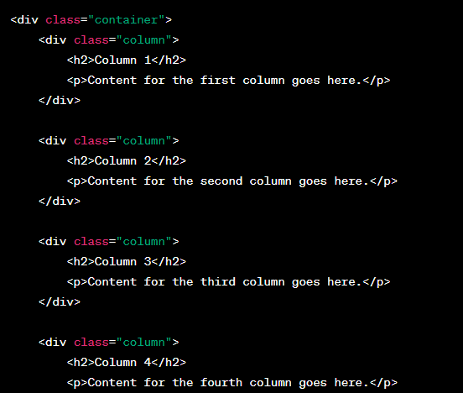
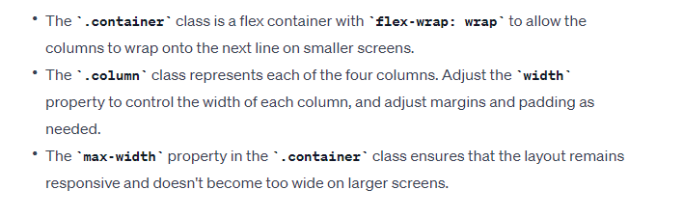

Slide 17
Responsive Four Column Layout with Flex
<!DOCTYPE html>
<html>
<head>
<meta name="viewport" content="width=device-width, initial-scale=1">
<style>
* {
box-sizing: border-box;
}
/* Container for flexboxes */
.row {
display: flex;
flex-wrap: wrap;
}
/* Create four equal columns */
.column {
flex: 25%;
padding: 20px;
}
/* On screens that are 992px wide or less, go from four columns to two columns */
@media screen and (max-width: 992px) {
.column {
flex: 50%;
}
}
<div class="row">
<div class="column" style="background-color:#aaa;">
<h2>Column 1</h2>
<p>Some text..</p>
</div>
<div class="column" style="background-color:#bbb;">
<h2>Column 2</h2>
<p>Some text..</p>
</div>
<div class="column" style="background-color:#ccc;">
<h2>Column 3</h2>
<p>Some text..</p>
</div>
<div class="column" style="background-color:#ddd;">
<h2>Column 4</h2>
<p>Some text..</p>
</div>
</div>
/* On screens that are 600px wide or less, make the columns stack on top of each other instead of next to each other */
@media screen and (max-width: 600px) {
.row {
flex-direction: column;
}
}
</style>
</head>
Resize the browser window to see the responsive effect. On screens that are 992px wide or less, the columns will resize from four columns to two columns. On screens that are 600px wide or less, the columns will stack on top of each other instead of next to eachother.

Slide 18
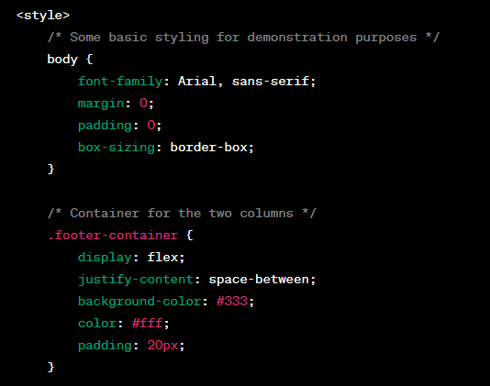
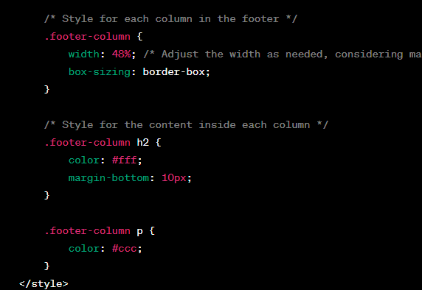
Two-column footer in HTML
Creating a two-column footer in HTML involves using HTML elements to structure the content and applying CSS for styling.

Slide 19
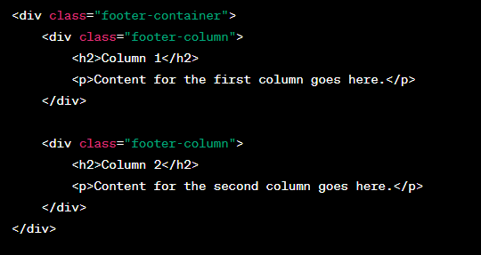
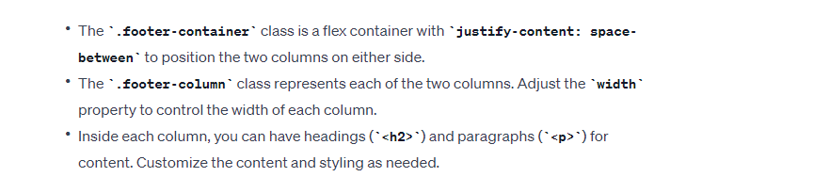

Slide 20
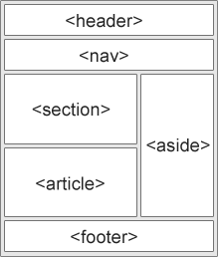
HTML Layout Elements HTML has several semantic elements that define the different parts of a web page:
<header> - Defines a header for a document or a section
<nav> - Defines a set of navigation links
<section> - Defines a section in a document
<article> - Defines an independent, self-contained content
<aside> - Defines content aside from the content (like a sidebar)
<footer> - Defines a footer for a document or a section
<details> - Defines additional details that the user can open and close on demand
<summary> - Defines a heading for the <details> element

Slide 21
HTML Layout Techniques
There are four different techniques to create multicolumn layouts. Each technique has its pros and cons:
CSS framework
CSS float property
CSS flexbox
CSS grid

Slide 22
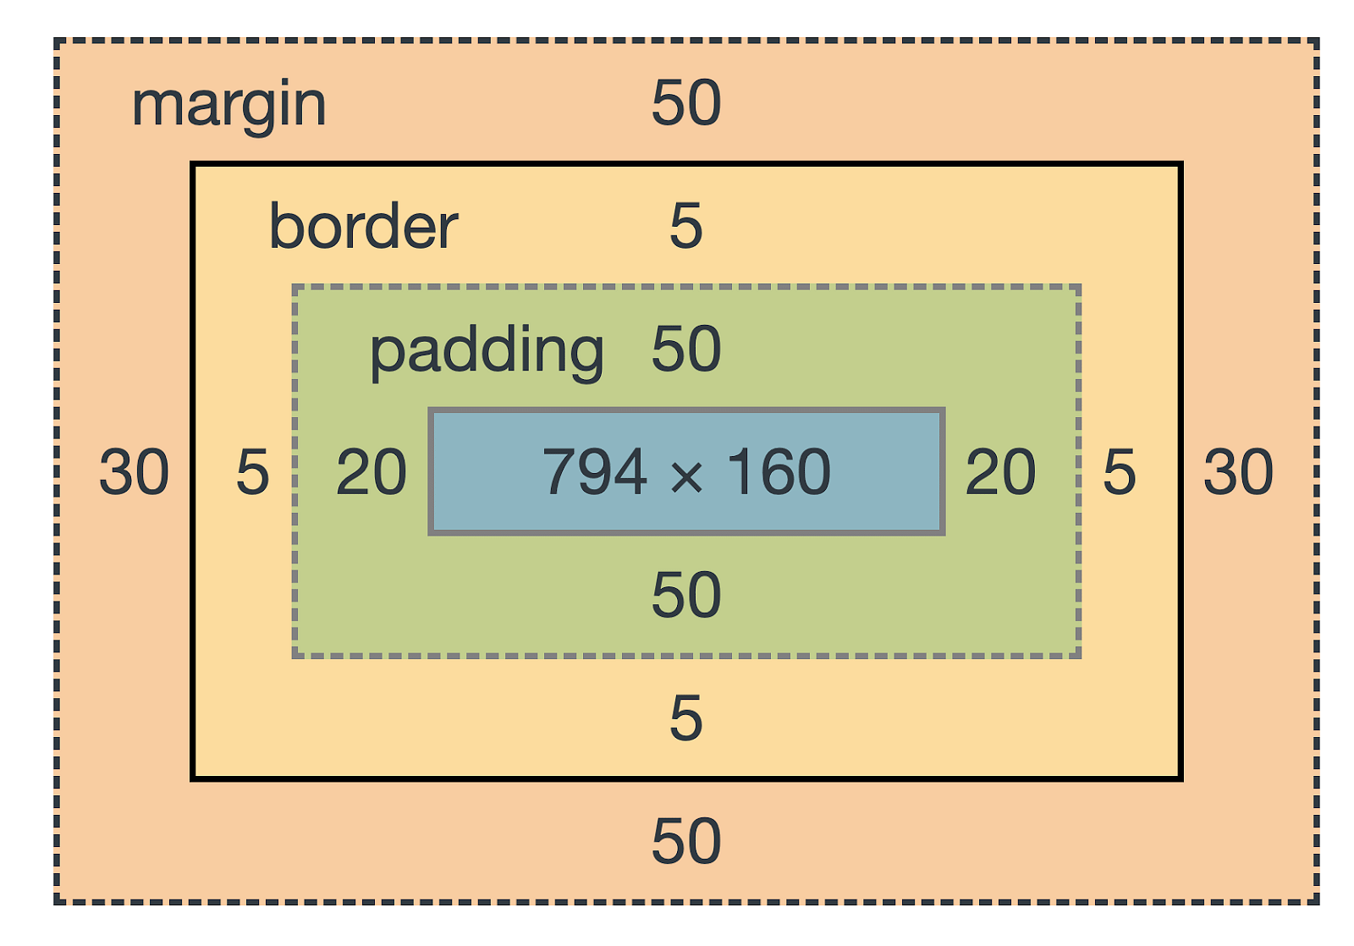
Box Model

Slide 23
CSS Box Model
The CSS box model is essentially a box that wraps around every HTML element. It consists of: margins, borders, padding, and the actual content

Slide 24
Explanation of the different parts:
Content - The content of the box, where text and images appear
Padding - Clears an area around the content. The padding is transparent
Border - A border that goes around the padding and content
Margin - Clears an area outside the border. The margin is transparent
The box model allows us to add a border around elements, and to define space between elements.

Slide 25
the box model style:
div { width: 300px; border: 15px solid green; padding: 50px; margin: 20px; }

Slide 26
CSS Outline
An outline is a line drawn outside the element's border.
CSS has the following outline properties:
outline-style
outline-color
outline-width
outline-offset
outline

Slide 27
CSS Outline Style
The outline-style property specifies the style of the outline, and can have one of the following values:
dotted - Defines a dotted outline
dashed - Defines a dashed outline
solid - Defines a solid outline
double - Defines a double outline
groove - Defines a 3D grooved outline
ridge - Defines a 3D ridged outline
inset - Defines a 3D inset outline
outset - Defines a 3D outset outline
none - Defines no outline
hidden - Defines a hidden outline

Slide 28
Demonstration of the different outline styles:
p.dotted {outline-style: dotted;} p.dashed {outline-style: dashed;} p.solid {outline-style: solid;} p.double {outline-style: double;} p.groove {outline-style: groove;} p.ridge {outline-style: ridge;} p.inset {outline-style: inset;} p.outset {outline-style: outset;}

Slide 29
CSS Outline Width
The outline-width property specifies the width of the outline, and can have one of the following values:
thin (typically 1px)
medium (typically 3px)
thick (typically 5px)
A specific size (in px, pt, cm, em, etc)

Slide 30
The following example shows some outlines with different widths:
p.ex1 { border: 1px solid black; outline-style: solid; outline-color: red; outline-width: thin; } p.ex2 { border: 1px solid black; outline-style: solid; outline-color: red; outline-width: medium; } p.ex3 { border: 1px solid black; outline-style: solid; outline-color: red; outline-width: thick; } p.ex4 { border: 1px solid black; outline-style: solid; outline-color: red; outline-width: 4px; }

Slide 31
CSS Outline Color
The outline-color property is used to set the color of the outline.
The color can be set by:
name - specify a color name, like "red"
HEX - specify a hex value, like "#ff0000"
RGB - specify a RGB value, like "rgb(255,0,0)"
HSL - specify a HSL value, like "hsl(0, 100%, 50%)"
invert - performs a color inversion (which ensures that the outline is visible, regardless of color background)

Slide 32
p.ex1 { border: 2px solid black; outline-style: solid; outline-color: red; } p.ex2 { border: 2px solid black; outline-style: dotted; outline-color: blue; } p.ex3 { border: 2px solid black; outline-style: outset; outline-color: grey; }

Slide 33
CSS Links
Links can be styled with any CSS property (e.g. color, font-family, background, etc.).
The four links states are:
a:link - a normal, unvisited link
a:visited - a link the user has visited
a:hover - a link when the user mouses over it
a:active - a link the moment it is clicked

Slide 34
/* unvisited link */ a:link { color: red; } /* visited link */ a:visited { color: green; } /* mouse over link */ a:hover { color: hotpink; } /* selected link */ a:active { color: blue; }
<p><b><a href="default.asp" target="_blank">This is a link</a></b></p>

Slide 35
Background Color
a:link { background-color: yellow; } a:visited { background-color: cyan; } a:hover { background-color: lightgreen; } a:active { background-color: hotpink; }
Try it Yourself »

Slide 36
CSS Lists
In HTML, there are two main types of lists:
unordered lists (<ul>) - the list items are marked with bullets
ordered lists (<ol>) - the list items are marked with numbers or letters
The CSS list properties allow you to:
Set different list item markers for ordered lists
Set different list item markers for unordered lists
Set an image as the list item marker
Add background colors to lists and list items

Slide 37
Different List Item Markers
ul.a { list-style-type: circle; } ul.b { list-style-type: square; } ol.c { list-style-type: upper-roman; } ol.d { list-style-type: lower-alpha; }

Slide 38
The list-style-image property specifies an image as the list item marker:
ul { list-style-image: url('sqpurple.gif'); }

Slide 39
Styling List With Colors
ol { background: #ff9999; padding: 20px; } ul { background: #3399ff; padding: 20px; } ol li { background: #ffe5e5; color: darkred; padding: 5px; margin-left: 35px; } ul li { background: #cce5ff; color: darkblue; margin: 5px; }

Slide 40
Text Color and Background Color
body { background-color: lightgrey; color: blue; } h1 { background-color: black; color: white; } div { background-color: blue; color: white; }

Slide 41
Text Indentation
The text-indent property is used to specify the indentation of the first line of a text:
Example
p { text-indent: 50px; }

Slide 42
Letter Spacing
h1 { letter-spacing: 5px; } h2 { letter-spacing: -2px; }

Slide 43
Line Height
p.small { line-height: 0.8; } p.big { line-height: 1.8; }

Slide 44
Word Spacing
p.one { word-spacing: 10px; } p.two { word-spacing: -2px; }

Slide 45
CSS Text Shadow
h1 { text-shadow: 2px 2px red; }

Slide 46
CSS Margins
p { margin-top: 100px; margin-bottom: 100px; margin-right: 150px; margin-left: 80px; }
Try it Yourself

Slide 47
CSS Overflow
The overflow property specifies whether to clip the content or to add scrollbars when the content of an element is too big to fit in the specified area.
The overflow property has the following values:
visible - Default. The overflow is not clipped. The content renders outside the element's box
hidden - The overflow is clipped, and the rest of the content will be invisible
scroll - The overflow is clipped, and a scrollbar is added to see the rest of the content
auto - Similar to scroll, but it adds scrollbars only when necessary
div { width: 200px; height: 65px; background-color: coral; overflow: visible; }

Slide 48
CSS Navigation Bar
Having easy-to-use navigation is important for any web site.
With CSS you can transform boring HTML menus into good-looking navigation bars.
Navigation Bar = List of Links
A navigation bar needs standard HTML as a base.

Slide 49
A navigation bar is basically a list of links, so using the <ul> and <li> elements makes perfect sense:
<ul> <li><a href="default.asp">Home</a></li> <li><a href="news.asp">News</a></li> <li><a href="contact.asp">Contact</a></li> <li><a href="about.asp">About</a></li> </ul>
ul { list-style-type: none; margin: 0; padding: 0; }

Slide 50
li {
float: left;
}
li a {
display: block;
color: white;
text-align: center;
padding: 14px 16px;
text-decoration: none;
}
li a:hover {
background-color: #111;
}
</style>
<style>
ul {
list-style-type: none;
margin: 0;
padding: 0;
overflow: hidden;
background-color: #333;
}
<ul>
<li><a class="active" href="#home">Home</a></li>
<li><a href="#news">News</a></li>
<li><a href="#contact">Contact</a></li>
<li><a href="#about">About</a></li>
</ul>

Slide 51
grouping/nesting
You can give the same properties to a number of selectors without having to repeat them.
h2 { color: red; } .thisOtherClass { color: red; } .yetAnotherClass { color: red; }
h2, .thisOtherClass, .yetAnotherClass
{ color: red; }

Slide 52
Nesting
If the CSS is structured well, there shouldn’t be a need to use many class or ID selectors. This is because you can specify properties to selectors within other selectors.

Slide 53
#top
{ background-color: #ccc; padding: 1em }
#top h1 { color: #ff0; }
#top p { color: red; font-weight: bold; }
This removes the need for classes or IDs on the p and h1 tags if it is applied to HTML that looks something like this:
<div id="top">
<h1>Hello head</h1>
\ <p>This is new paragraph</p>
<p>this also</p>
</div>

Slide 54
CSS Dimension
The CSS height and width properties are used to set the height and width of an element.
The CSS max-width property is used to set the maximum width of an element.
div { height: 200px; width: 50%; background-color: powderblue; }
div { max-width: 500px; height: 100px; background-color: powderblue; }

Slide 55
All CSS Dimension Properties
Property | Description
height | Sets the height of an element
max-height | Sets the maximum height of an element
max-width | Sets the maximum width of an element
min-height | Sets the minimum height of an element
min-width | Sets the minimum width of an element
width | Sets the width of an element

Slide 56
CSS display Property
The display property specifies the display behavior (the type of rendering box) of an element.
.a { display: contents; border: 2px solid red; background-color: #ccc; padding: 10px; width: 200px; } .b { border: 2px solid blue; background-color: lightblue; padding: 10px; }
p.ex1 {display: none;} p.ex2 {display: inline;} p.ex3 {display: block;} p.ex4 {display: inline-block;}

Slide 57
Value | Description
inline | Displays an element as an inline element (like <span>). Any height and width properties will have no effect
block | Displays an element as a block element (like <p>). It starts on a new line, and takes up the whole width
contents | Makes the container disappear, making the child elements children of the element the next level up in the DOM
flex | Displays an element as a block-level flex container
grid | Displays an element as a block-level grid container
inline-block | Displays an element as an inline-level block container. The element itself is formatted as an inline element, but you can apply height and width values
inline-flex | Displays an element as an inline-level flex container
inline-grid | Displays an element as an inline-level grid container
div { display: flex; flex-direction: row-reverse; }

Slide 58
CSS Layout - The position Property
position property specifies the type of positioning method used for an element.
There are five different position values:
static
relative
fixed
absolute
sticky
Elements are then positioned using the top, bottom, left, and right properties. However, these properties will not work unless the position property is set first. They also work differently depending on the position value.

Slide 59
An element with position: static; is not positioned in any special way; it is always positioned according to the normal flow of the page:
An element with position: relative; is positioned relative to its normal position.
An element with position: fixed; is positioned relative to the viewport, which means it always stays in the same place even if the page is scrolled. The top, right, bottom, and left properties are used to position the element.
A fixed element does not leave a gap in the page where it would normally have been located.
An element with position: absolute; is positioned relative to the nearest positioned ancestor (instead of positioned relative to the viewport, like fixed).
div.relative { position: relative; width: 400px; height: 200px; border: 3px solid #73AD21; }
div.absolute { position: absolute; top: 80px; right: 0; width: 200px; height: 100px; border: 3px solid #73AD21; }

Slide 60
All CSS Positioning Properties
Property | Description
bottom | Sets the bottom margin edge for a positioned box
clip | Clips an absolutely positioned element
left | Sets the left margin edge for a positioned box
position | Specifies the type of positioning for an element
right | Sets the right margin edge for a positioned box
top | Sets the top margin edge for a positioned box
div.absolute { position: absolute; bottom: 10px; width: 50%; border: 3px solid #8AC007; }

Slide 61
CSS Layout - float and clear
The CSS float property specifies how an element should float.
The CSS clear property specifies what elements can float beside the cleared element and on which side.
The float property is used for positioning and formatting content e.g. let an image float left to the text in a container.
The float property can have one of the following values:
left - The element floats to the left of its container
right - The element floats to the right of its container
none - The element does not float (will be displayed just where it occurs in the text). This is default
inherit - The element inherits the float value of its parent

Slide 62
Types of css and their usage in html5
Inline CSS has the highest priority, then comes Internal/Embedded followed by External CSS which has the least priority. Multiple style sheets can be defined on one page.

Slide 63
The Internal CSS has <style> tag in the <head> section of the HTML document. This CSS style is an effective way to style single pages. Using the CSS style for multiple web pages is time-consuming because we require placing the style on each web page.
<head>
<style>
body {
background-color: black;
}
h1 {
color: red;
padding: 50px;
}
</style>
</head>

Slide 64
Pros of Internal CSS
Internal CSS cannot upload multiple files when we add the code with the HTML page.
Cons of Internal CSS:
Adding code in the HTML document will reduce the page size and loading time of the webpage.

Slide 65
External CSS
In external CSS, we link the web pages to the external .css file. It is created by text editor. The CSS is more efficient method for styling a website. By editing the .css file, we can change the whole site at once.
Create a new .css file with text editor, and add Cascading Style Sheet rules too.
Add a reference to the external .cssfile right after <title> tag in the <head> section of HTML sheet:
<link rel="stylesheet" type="text/css" href="style.css" />

Slide 66
Pros of External CSS:
Our files have a cleaner structure and smaller in size.
We use the same .css file for multiple web pages in external CSS.
Cons of External CSS:
The pages cannot be delivered correctly before the external CSS is loaded.
In External CSS, uploading many CSS files can increase the download time of a website.

Slide 67
Inline CSS is used to style a specific HTML element. Add a style attribute to each HTML tag without using the selectors. Managing a website may difficult if we use only inline CSS. However, Inline CSS in HTML is useful in some situations. We have not access the CSS files or to apply styles to element.
<body style="background-color:white;">
<h1 style="color:Red;padding:20px;">CSS Tutorials</h1>
<p style="color:blue;">It will be useful here.</p>
Pros of inline CSS:
We can create CSS rules on the HTML page.
We cannot create and upload a separate document in inline CSS.
Cons of inline CSS:
Inline CSS, adding CSS rules to HTML elements is time-consuming and messes up the HTML structure.
It styles multiple elements at the same time which can affect the page size and download time of the page.

